Slide 1
THE RISE AND FALL AND THE REVIVAL OF GAMES
Av: Bernt Leander Vargan, Adam Emile Aske, Sindre Rosenlind

Slide 2
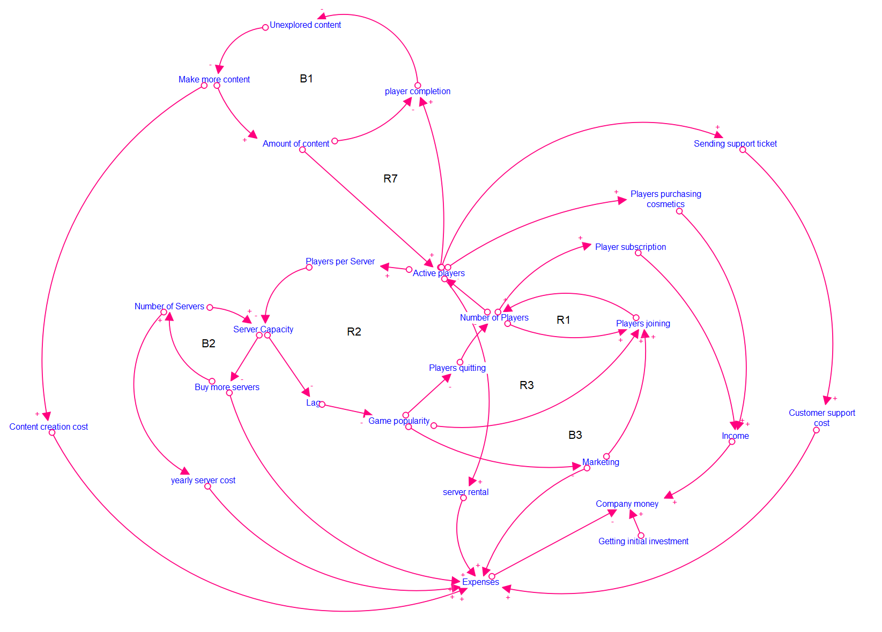
CLD:

Slide 3
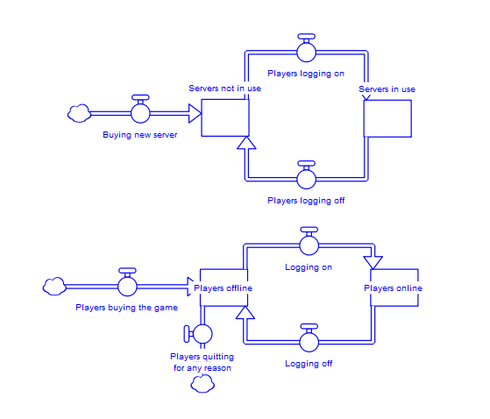
FLOW CHARTS:

Slide 4
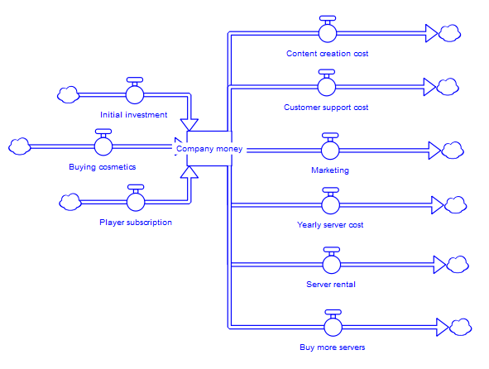
FLOW CHARTS:

Slide 5
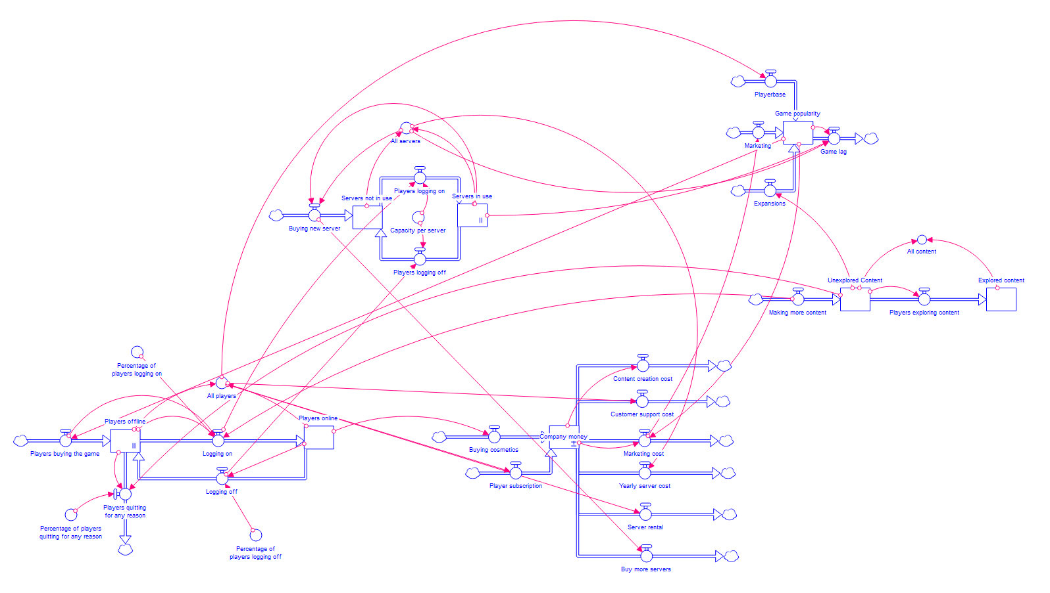
STELLA MODEL:

Slide 6
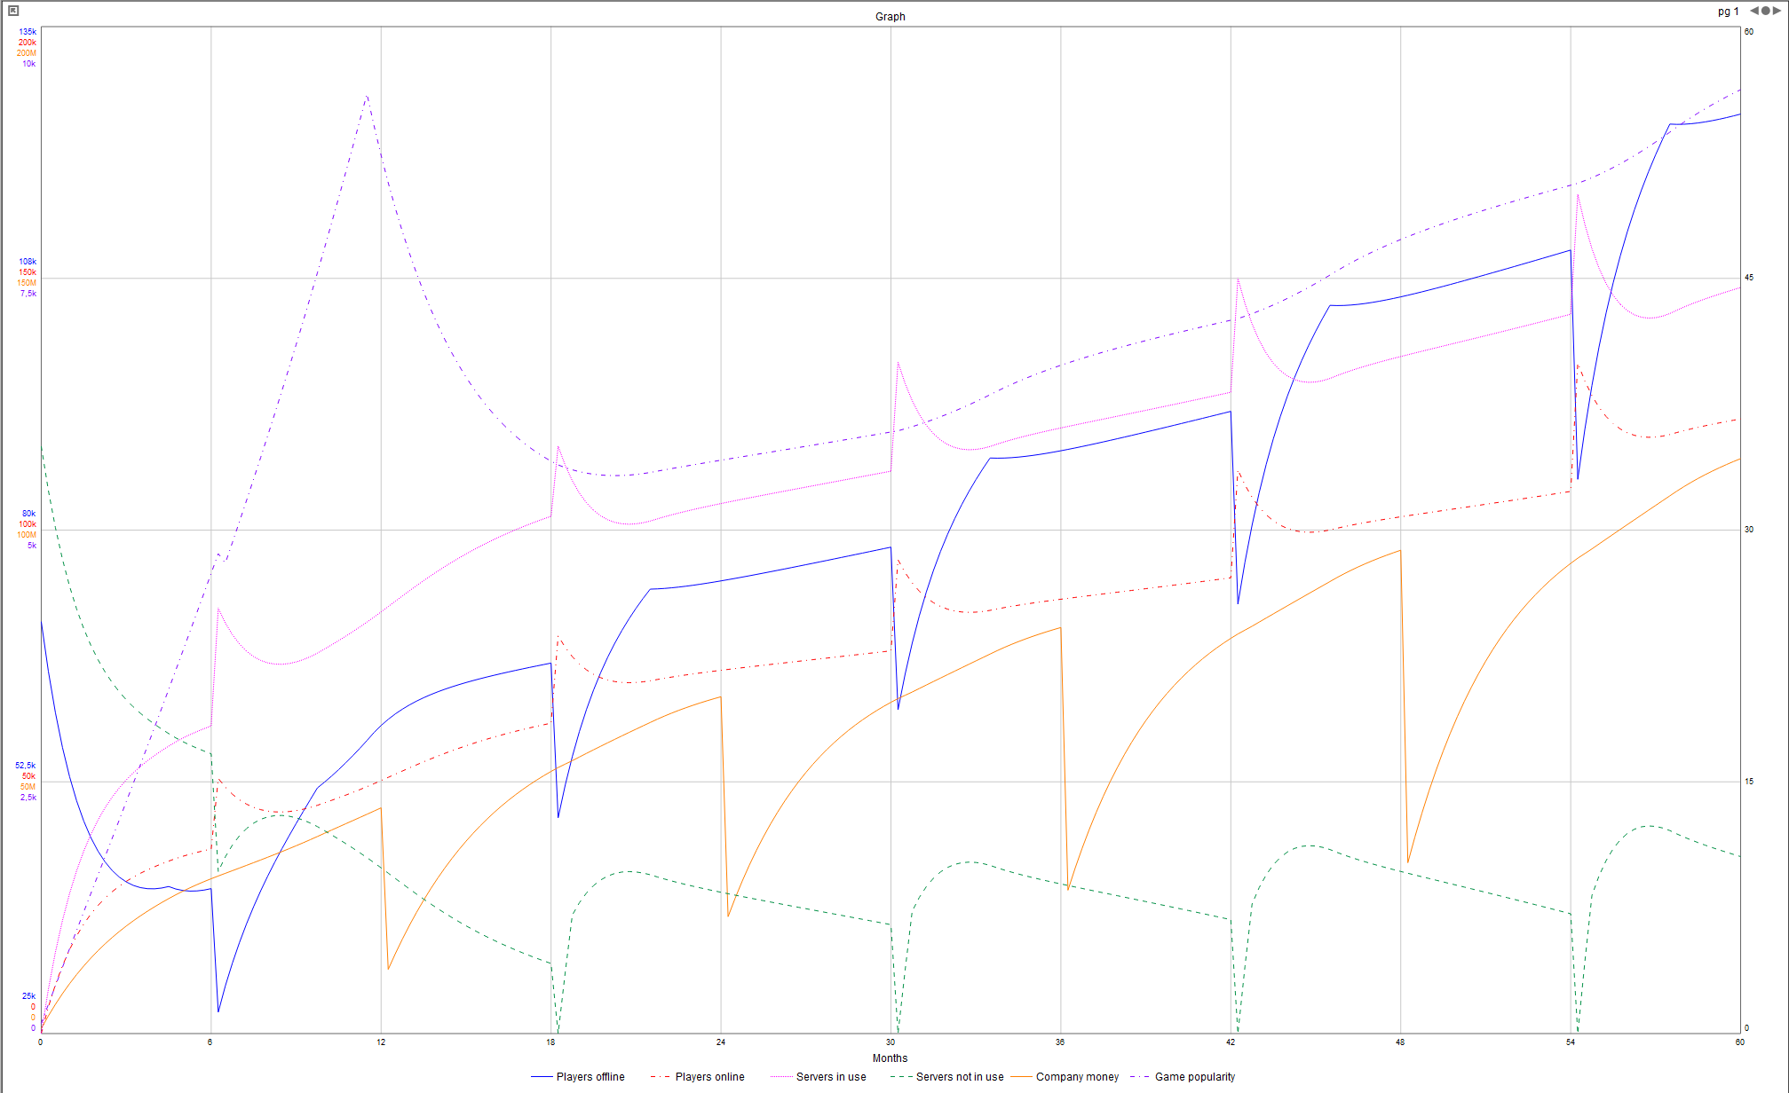
RESULTS:

